Slide 1
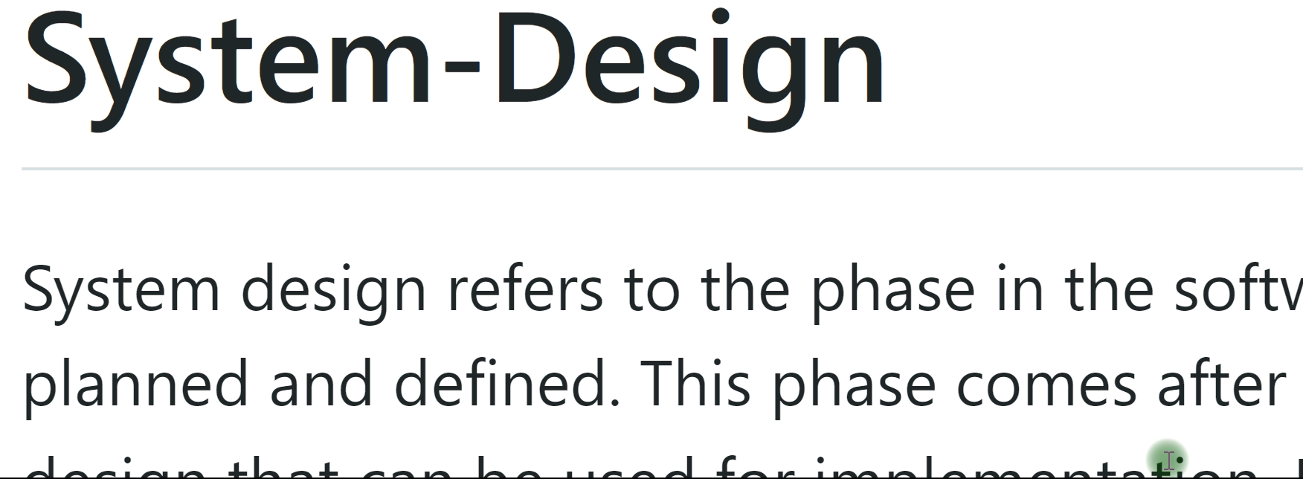
Mindmap for System Design
Setting the Roadmap
Setting the Context

Slide 2
Agenda
Problem statement
Possible solutions
Introducing
Rate limiter
Request throttling
Load shedding
Similarities
Difference
Real life industry examples

